Slide 1
Smart Surveillance System using Computer Vision

Slide 2
#Team:
Amit Sati
(Testing, Documentation)
Deepankar Sharma
(Coding-Python, CV)
Pawan Chandra
(Documentation , Presentation )

Slide 3
# Proposal:
The basic idea is to make Surveillance system “smart” by applying the Computer Vision Techniques to automatically generate alerts in case of mishaps like burglary so that one doesn’t need to physically monitor the cam feeds.

Slide 4
# Technology:
Python (Coding)
OpenCV (Computer Vision)
Django/Streamlit/Flask (Deployment)
MQTT / Firebase (realtime feed to user)
Twilio API (Alerts)

Slide 5

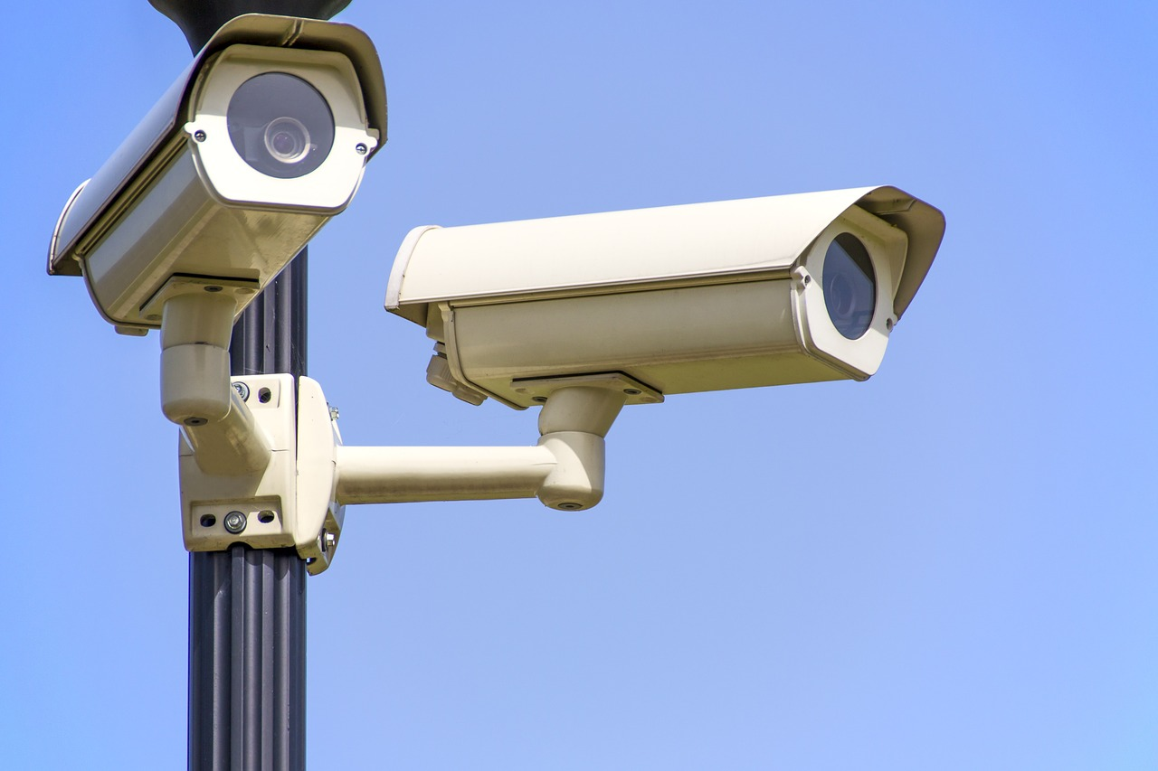

# Overview:
Here our model will do some processing !!!!!
Bro , there’s theif in the house !!!!

Slide 6
Thank You !!

